Slide 1
Analysis of Stock Profile for Netflix
2017 data

Slide 2
In my role as a data visualisation developer at Yahoo Finance! I have aided the Netflix stock profile team in visualising their stock data for 2017.
The following slides will share the following stock profile visualisations:
A distribution of the stock prices for Netflix in 2017
Netflix stock and revenue for the past four quarters and a summary
The earned versus actual earnings per Netflix share
Representation of 2017 stock market, through comparison of Netflix stock against the Dow Jones stock

Slide 3
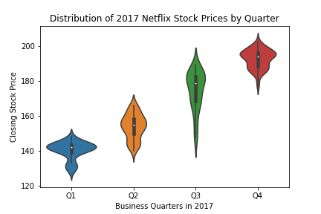
Distribution of the stock prices for Netflix in 2017
Median closing stock price was lowest in Q1(140) and rose each quarter, until highest in Q4(195).
However Q4 shows an almost bimodal distribution of closing stock price, with many days having a closing stock price of around 185, 10 points lower than the median price for the quarter.
Q3 shows the greatest fluctuation in closing stock price, with a larger IQR and outlier spread.

Slide 4
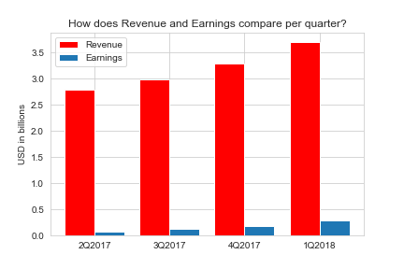
Revenue vs Earnings per Quarter
Revenue increased successively from quarter to quarter across 2017. As revenue increased so did earnings.
Per quarter earnings were approximately the following percentage of revenue:
Q1: 2.35%
Q2: 4.35%
Q3: 5.64%
Q4/Q1(2018): 7.84%

Slide 5
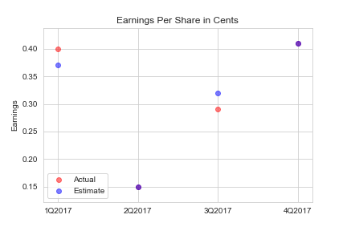
Estimated vs Actual earnings per share
The estimated earnings per share (blue dots) and actual earnings per share (red dots) are plotted on the left.
As can be observed there was no difference between the estimated and actual share prices for Q2 and Q4.
In Q3 and Q4 there was only a 0.03 cent difference between the estimated and actual share price. With the actual share price being higher in Q2, and the estimated share price being the higher value in Q3.
Therefore we can say that the estimate values were very accurate calculations.

Slide 6
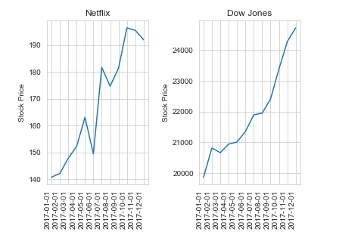
Netflix vs Dow Jones Stock Price per month
It can be observed that the Dow Jones stock price was considerably higher than the Netflix stock price in each month of 2017.
The Netflix stock price was much more volatile showing a sharp decreases and increases than the Dow Jones stock
Overall however, both stocks increased in price from beginning to the end of the year.

